Slide 1
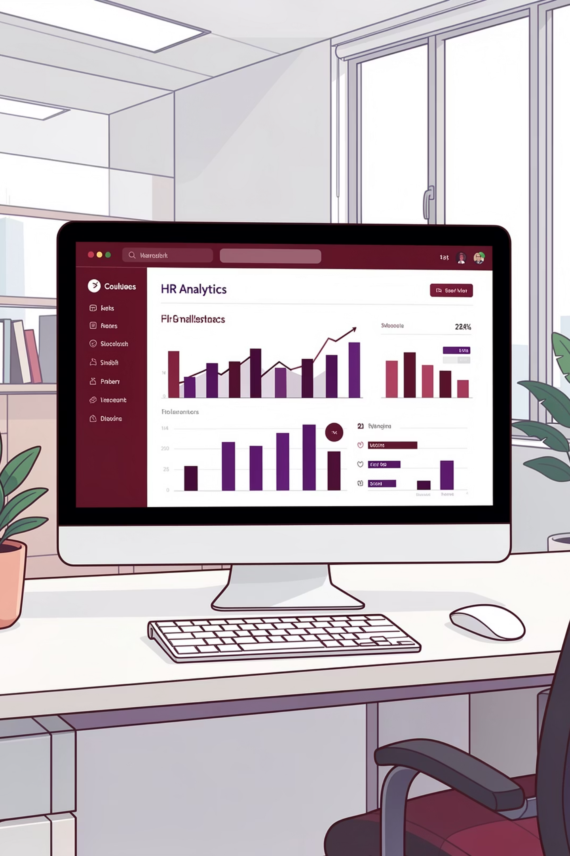
Human Resources Data Analytics Dashboard
Comprehensive workforce analysis enabling data-driven HR decisions through SQL transformation and Power BI visualization.

Slide 2

OBJECTIVES
Business Objectives
Demographics
Distribution
Turnover
Retention
Evaluate workforce by gender, age, and ethnicity
Analyze by department, job title, and location
Measure attrition rates and identify high-risk areas
Explore tenure trends and patterns

Slide 3

Tools & Technologies
Data Preparation
SQL Server Management Studio
Data cleaning & transformation
Visualization
Power BI dashboards
DAX calculated measures
Techniques
KPI calculations
Trend analysis

Slide 4
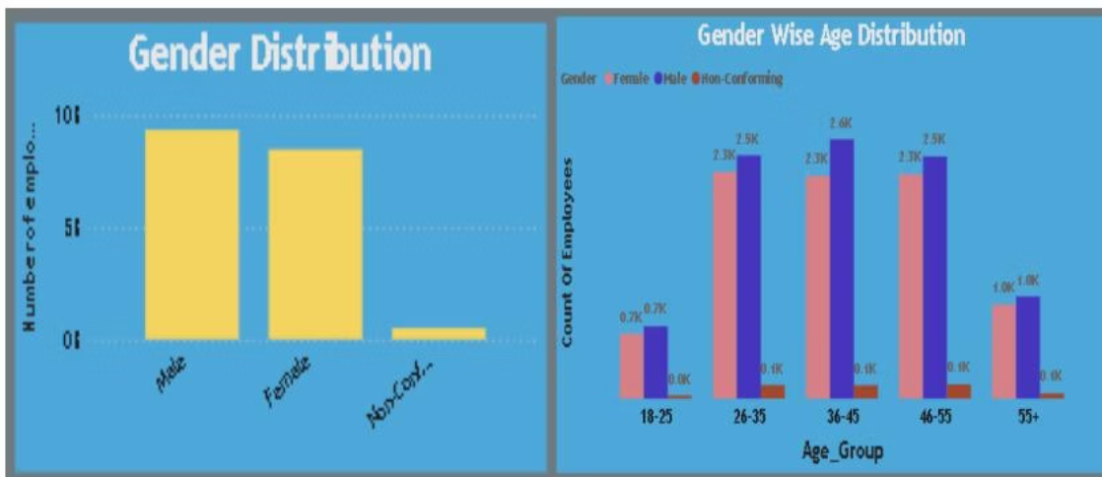
Gender Distribution & Age Analysis
Key Findings
Balanced gender distribution with 52% male, 48% female workforce.
Dominant age group: 25-35 years, indicating younger employee base.
Impacts retention strategies and training program design.

Slide 5
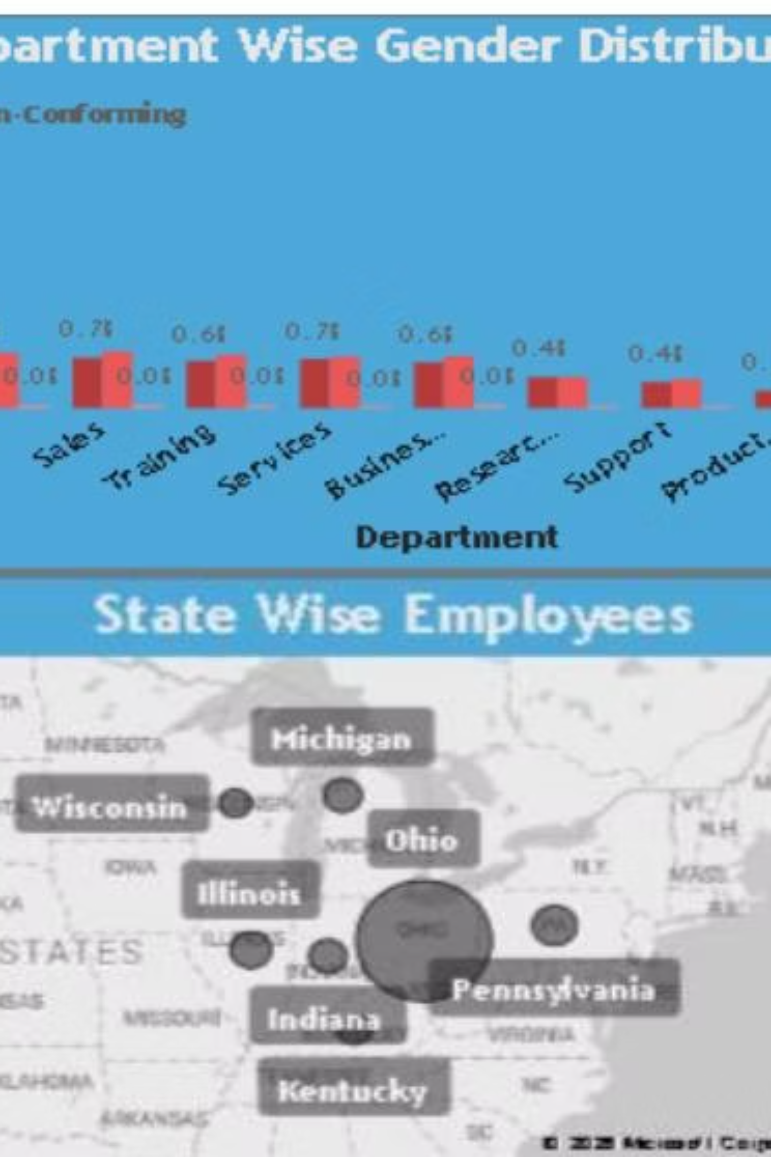
Department & Geographic Distribution
Engineering Leads
Pennsylvania Hub
Strategic Insight
Highest concentration with 2.8K employees
Largest geographic concentration of workforce
Informs workforce allocation and targeted HR interventions

Slide 6
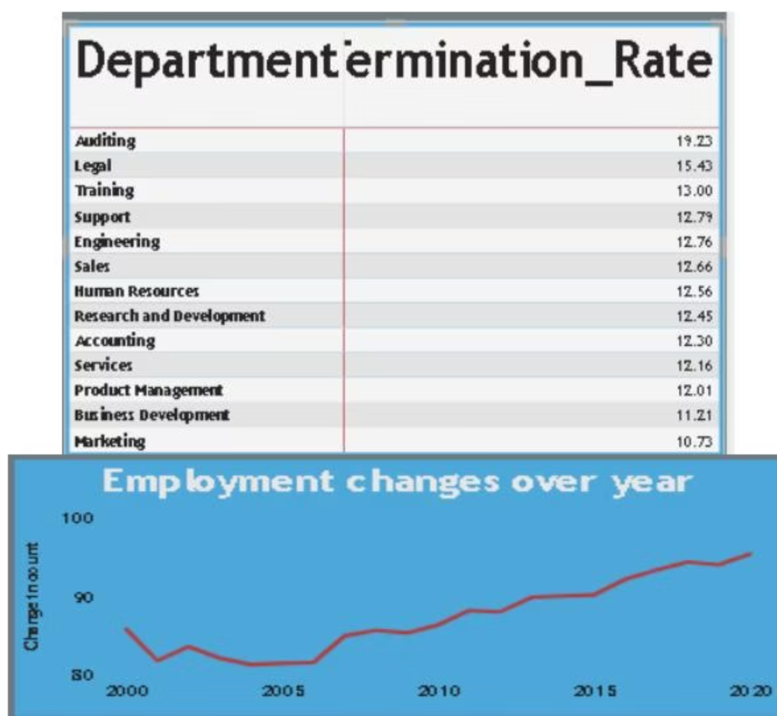
CRITICAL METRICS
Turnover & Attrition Trends
High-Risk Departments
Auditing: 19.23% turnover
Legal: 15.43% turnover
Training: 13.00% turnover
Departments exceeding 20% require immediate retention programs.

Slide 7
Employment Growth Trajectory
12%
8
YoY Growth
Avg Tenure
Year-over-year employee increase
Years of employment length
Steady Expansion
Consistent growth from 2000-2020 demonstrates organizational stability.
Technical roles show 22% higher tenure than operational roles.

Slide 8
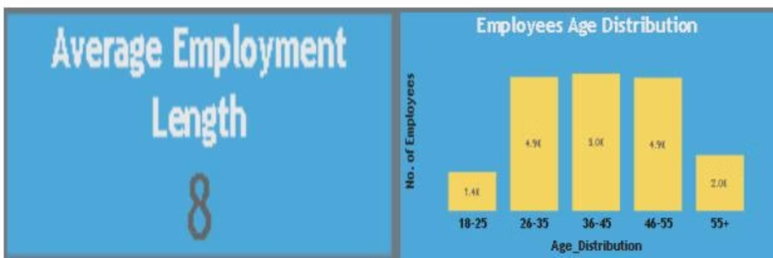
Age Distribution Insights
Workforce Composition
26-35 years: 4.9K employees
46-55 years: 4.9K employees
Two dominant age groups require different engagement strategies.

Slide 9



ACTION ITEMS
Strategic Recommendations
Retention Programs
Succession Planning
Hiring Strategy
Target high-turnover departments with focused initiatives
Build career paths using tenure insights
Plan recruitment by age, location, and department needs

Slide 10

Conclusion
HR Analytics Dashboard delivers actionable insights into workforce composition, turnover risks, and retention opportunities.
Empowering organizational leaders with real-time KPIs and strategic planning confidence through integrated SQL and Power BI solutions.

